Slide 1
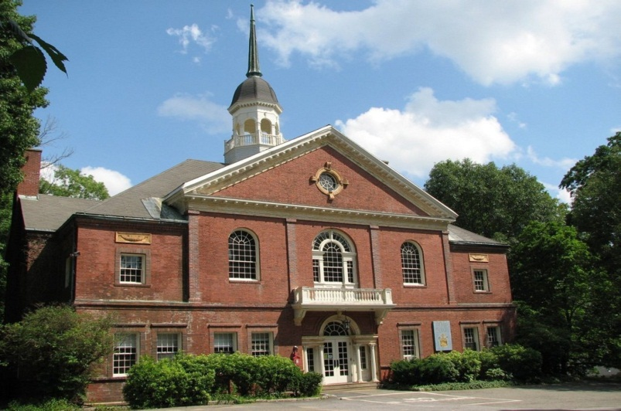
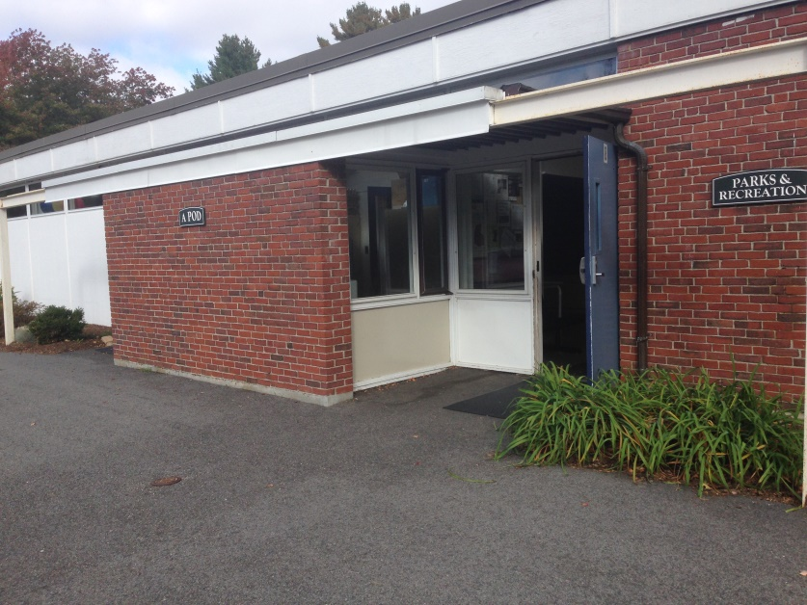
Why is Lincoln considering a Community Center?
Parks & Recreation
Council on Aging

Slide 2
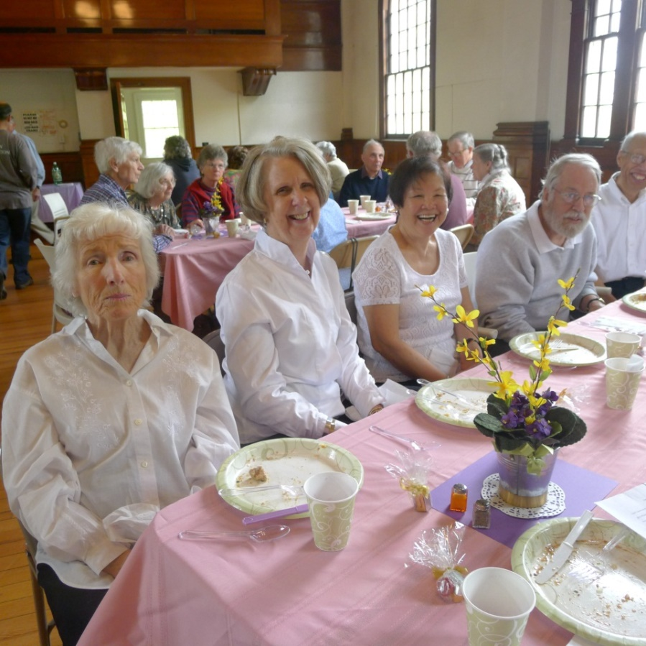
A growing senior population with expanded needs.
1,000 seniors in 1983 vs 1,900 now
COA served 1,100 people in FY14
10,000 visits to Bemis Hall/COA Activities in FY14.

Slide 3
What does the Council on Aging Offer?
Activities
Interest and discussion groups-languages, nutrition, handwork,
de-cluttering, current events, and more
Social events
Support groups
Lectures on the humanities, health, legal issues, caregiving, benefits, and more
Fitness, Tai Chi, Yoga, Tai Chi, line dancing classes
Art exhibits, classes and workshops; crafts workshops
Day trips to cultural, historical and other sites
Concerts- jazz, classical, modern
Sing-alongs and piano duet-playing
Holistic health groups – meditation, mind-body wellness
Monthly luncheons at St. Anne’s
Movies – current features, documentaries, foreign
Games – bridge, Mah Jongg
Music appreciation classes
Wellness for all ages and podiatry clinics
Computer classes and tutoring

Slide 4
Social and Other Individual Services
Information and referral
Assistance in arranging services and care management
Caregiver counseling
Transportation to medical appointments and other essential destinations
Medical equipment loan
Emergency financial assistance for all ages
Home safety checks
Help getting benefits for all ages
Minuteman SHINE health benefits counseling
Veterans counseling with Veterans Services Officer
File of Life
AARP/IRS Tax Aide program
Friendly Visiting

Slide 5
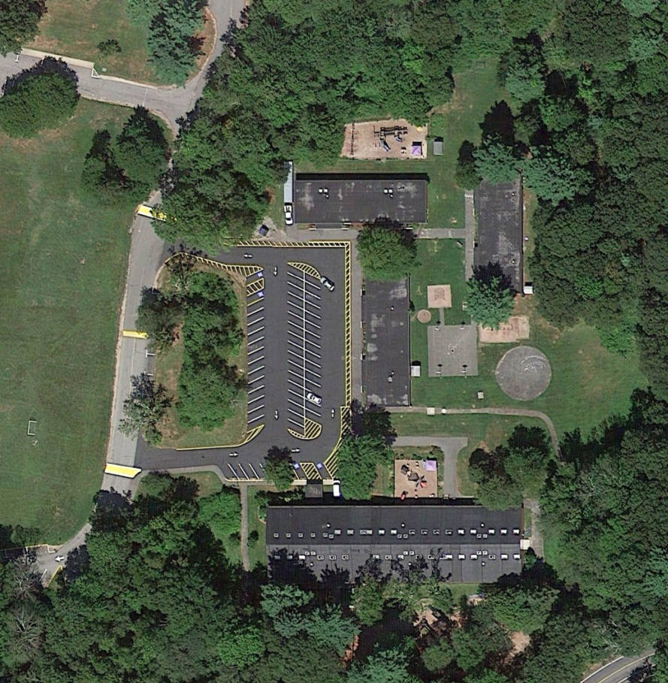
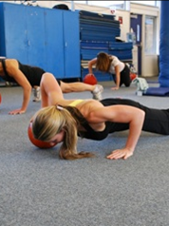
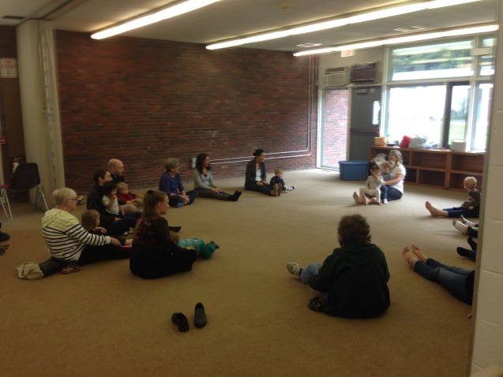
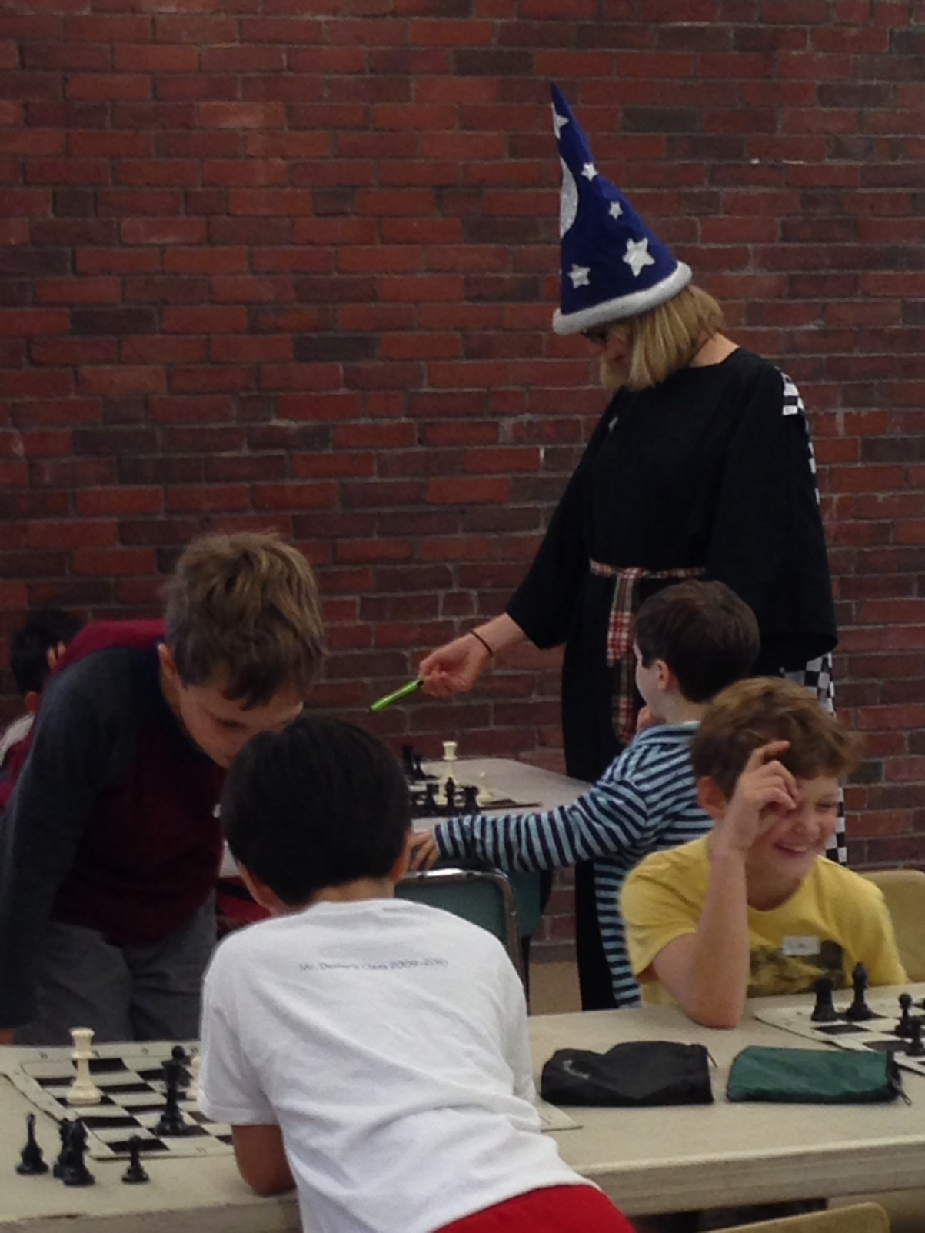
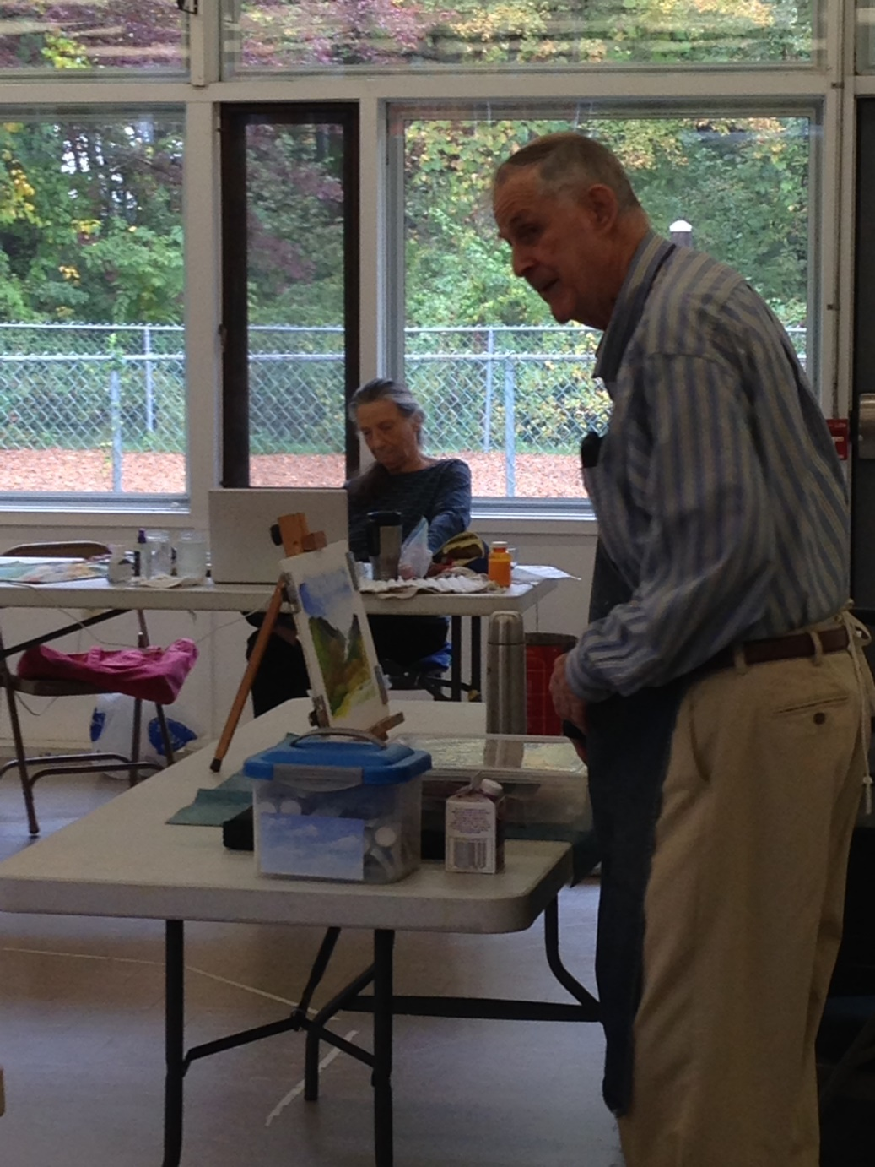
The Hartwell Pods were constructed in the late 1950’s as temporary classrooms. Classrooms moved out in 1996 when the schools expanded the Smith & Brooks Buildings with the “link project”. Parks and Recreation Office moved from Bemis Hall to the Hartwell Campus in 1998 and began programming in the available spaces.
The Hartwell Pods were constructed in the late 1950’s as temporary
classrooms. They became available to the community in 1996 upon completion of the school “link” project, when the schools moved out of them.

Slide 6
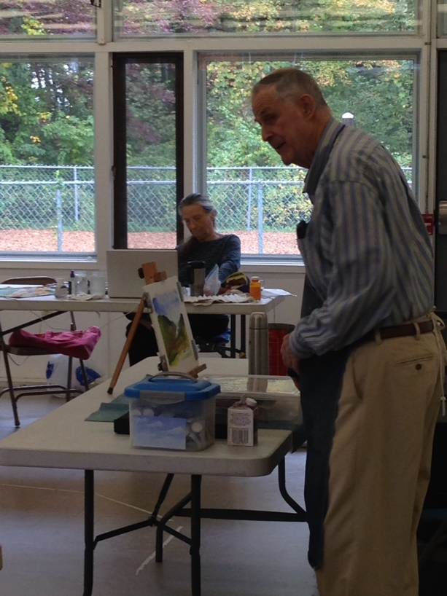
Pods are home to -Parks and Recreation -Lincoln School Maintenance -LEAP Afterschool Program
Provide Space for
-Lincoln Preschool
-Lincoln K-8 School
-Magic Garden Preschool
-Various community groups
Notes:
Talk about collaborations… efficient use of space.

Slide 7
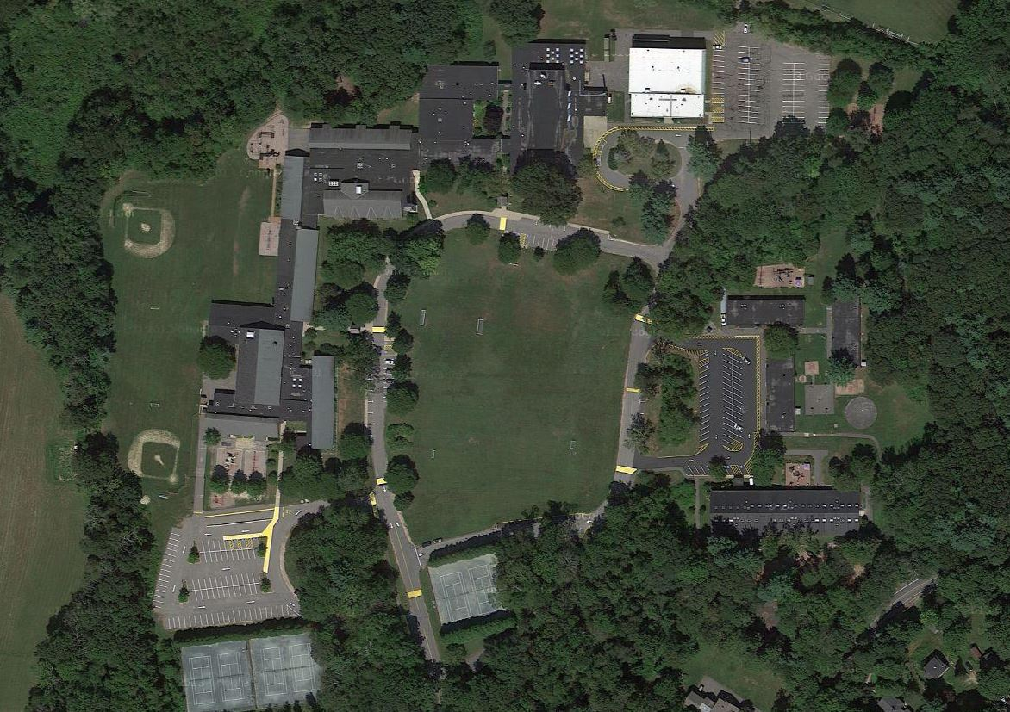
PRD HOME
Ballfield Road Campus
PRD FACILITIES
PRD ACCESS

Slide 8
Participation in the Past 12 Months Number of Individual Participants - 1,500 Number of Participants in All Activities - 3,500 Number of Programs and Events Offered – 100+ Our Youngest Participant – 8 months old Our Most Senior Participant – 93 years old Staffing Year Round 2 Full Time / 1 Part Time Seasonal App 55 staff between pool and camp staff App. 30 instructors Over 50 volunteers

Slide 9
Adult Programs
Ultimate Fitness
Open Studio
Ballroom Dancing
Pick up Basketball
Photography
CPR/First Aid
Tennis Lessons
Yoga
Nutritional Workshops
LOMA
Table Tennis
Skiing & Snowboarding Lessons
Kayaking & Canoeing
Trail Walks
Youth Programs
Archery
Basketball Clinics
Music Together
Super Soccer Stars
Tri-Town Basketball League
Home Safety Training
Babysitter’s Training
Middle School Dances
Skiing & Snowboarding Lessons
Sunday River Trip
Canobie Lake Park Trips
Floor Hockey
Variety Sports
Vaca-Playdays
Lego Robotics
Track & Field
Juggling Workshop
Fencing
Mad Science
Beehive Art Classes
Break-a-Sweat Workouts
Lacrosse Skills & Drills
Afterschool Library
Musical Theater
Spanish
IMLEM Math Team
Private Basketball Coaching
Tennis Lessons
Gymnastics
Farmer’s Helper
Intro to Computer Programming
Chess
Hip Hop Dance
Intro to Karate
Middle School Field Trips
Special Events
Winter Carnival Weekend
July 4th Celebration
Memorial Day Celebration
Patriot’s Day Celebration
Summer Concert Series
Lincoln Kids Triathlon
Trunk-or-Treat
Gobble Wobble
Haunted Barn
Fishing Derby
Summer Activities Best Soccer Camps
Super Soccer Stars Chess Wizard’s Camps
Lincoln Summer Day Camp
Codman Pool
Tennis Courts

Slide 10
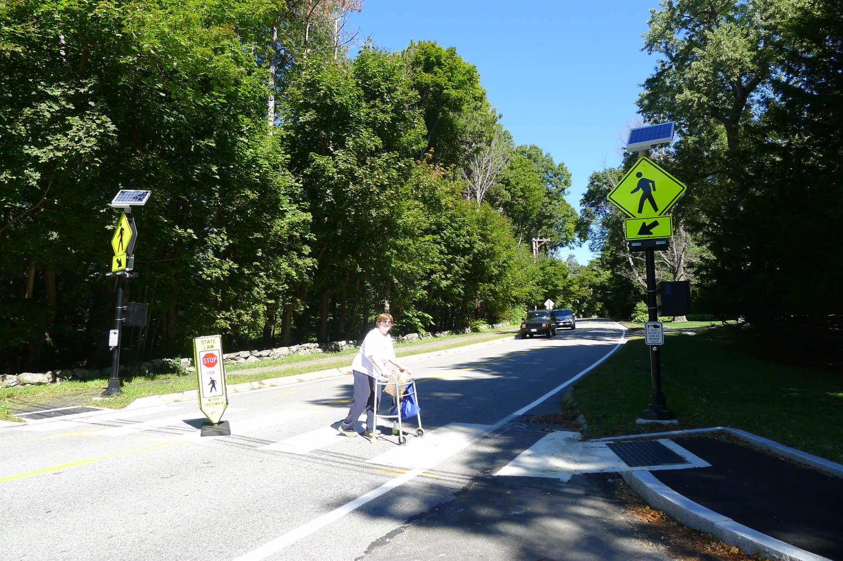
Safety Issues at Bemis Hall: 1. Crossing Bedford Road

Slide 11
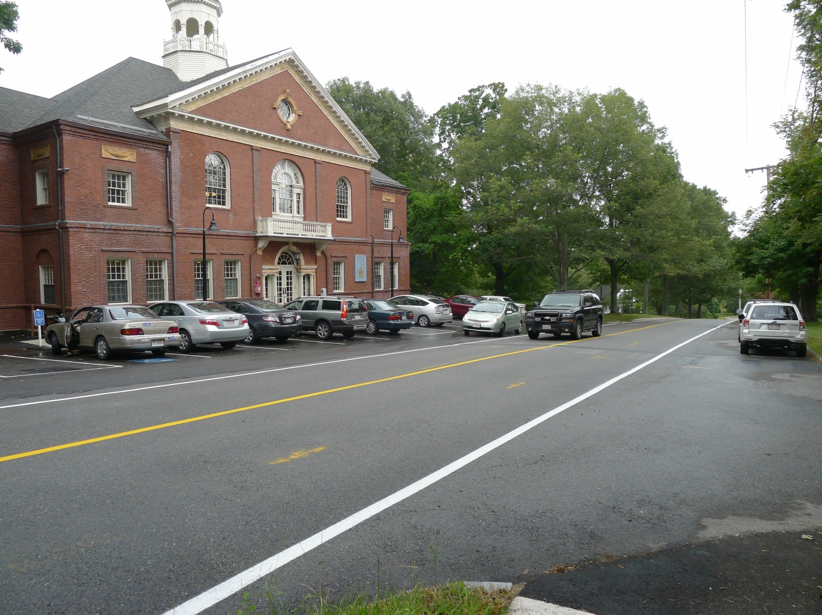
2. Pulling out into traffic

Slide 12
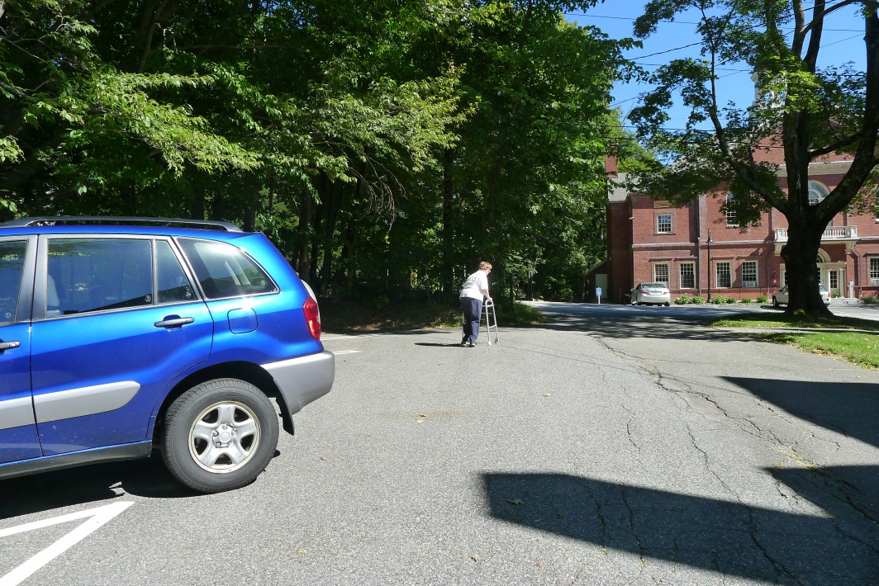
3. The distance from parking lot to Bemis is challenging for people with mobility disabilities.

Slide 13
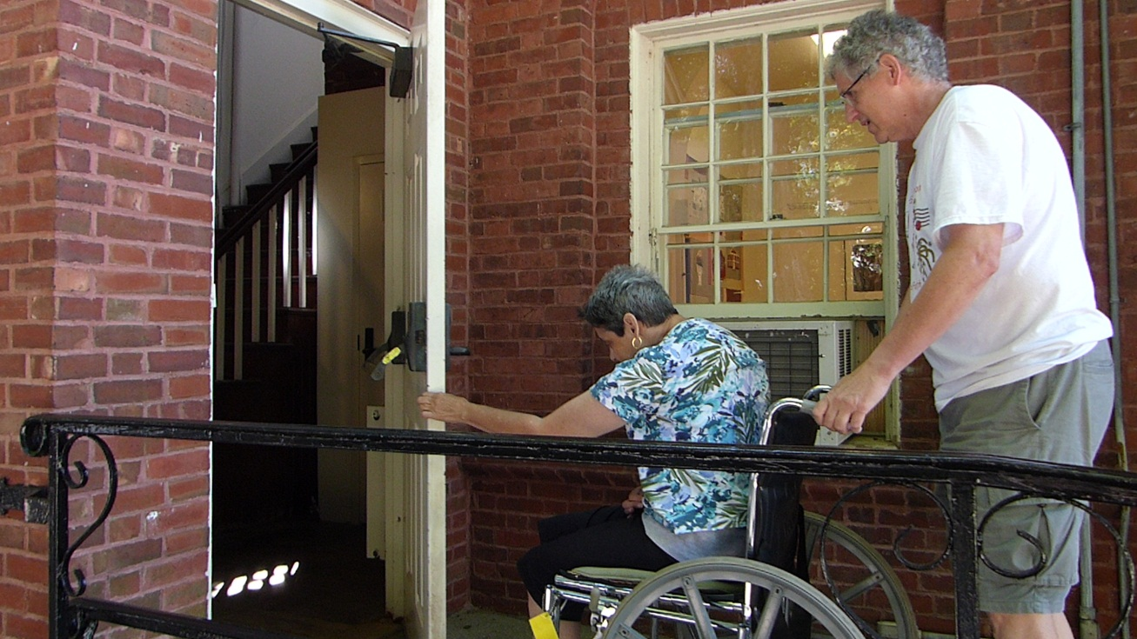
Accessibility issues at Bemis Hall: 1. Side Door

Slide 14
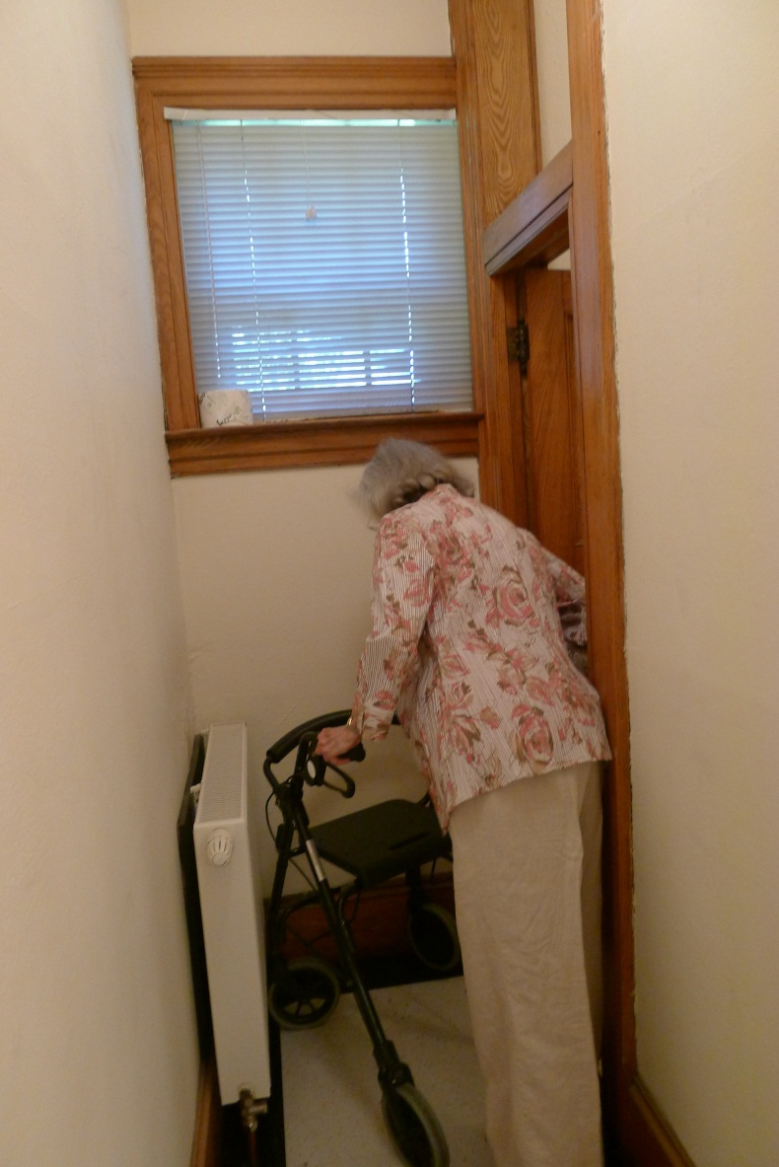
2. Bathrooms

Slide 15
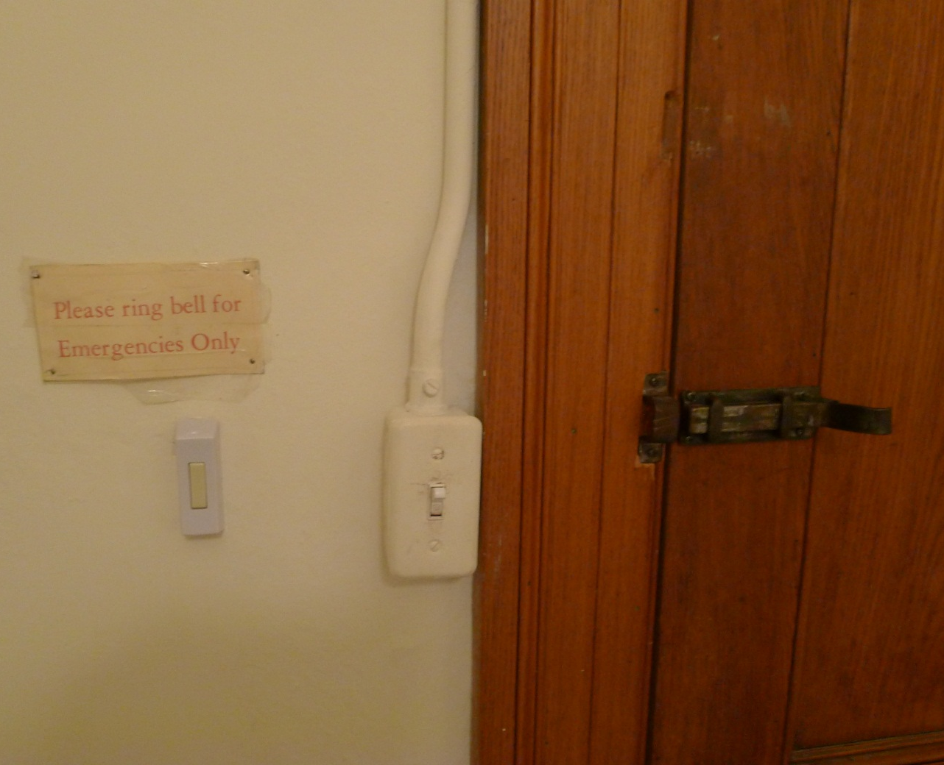

Slide 16
Confidentiality at Bemis Hall: 1. Reception Area in Lobby

Slide 17
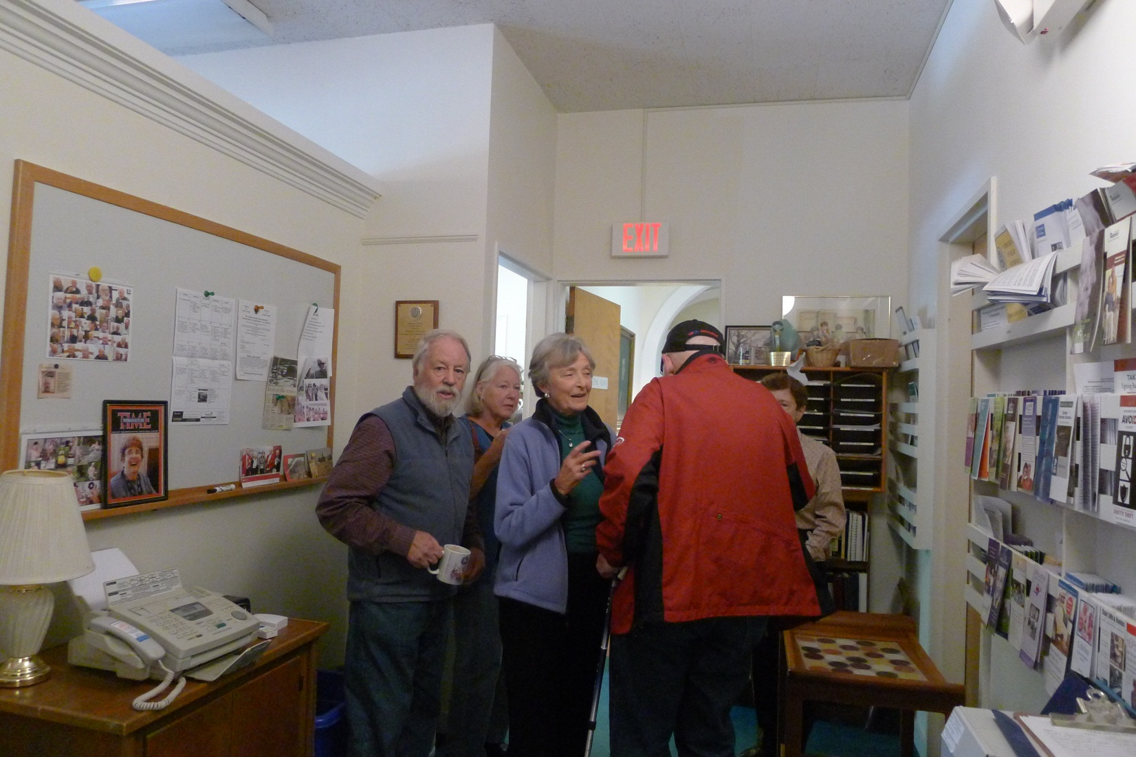
2. Staff Offices at Bemis Hall

Slide 18
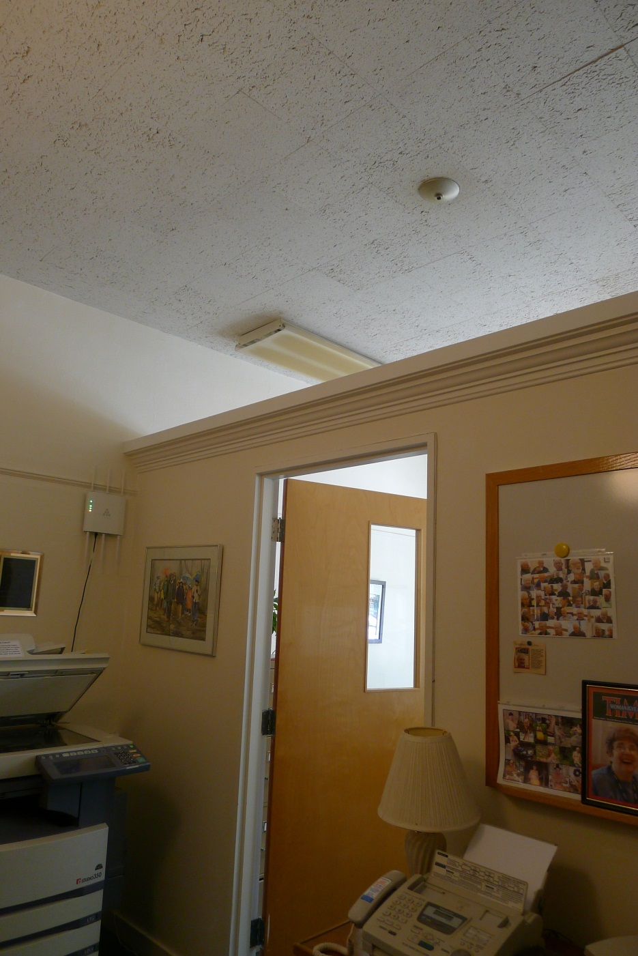

Slide 19
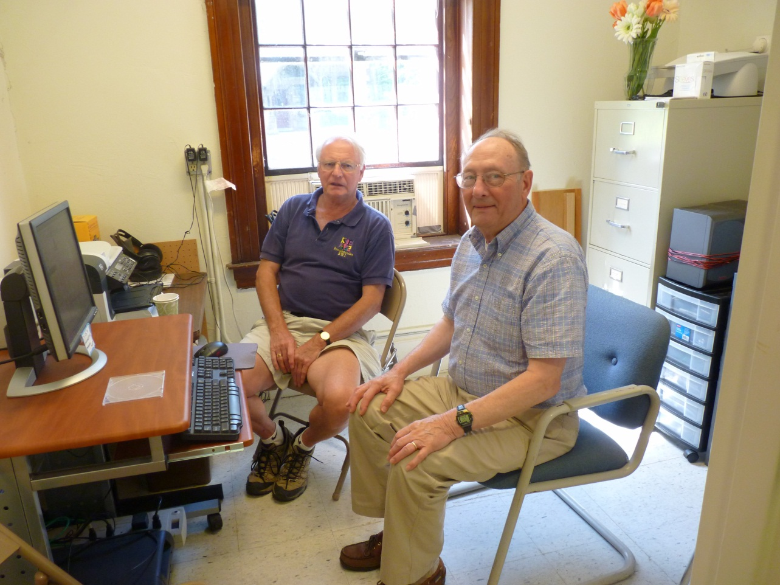
3. Volunteer Counseling Room

Slide 20
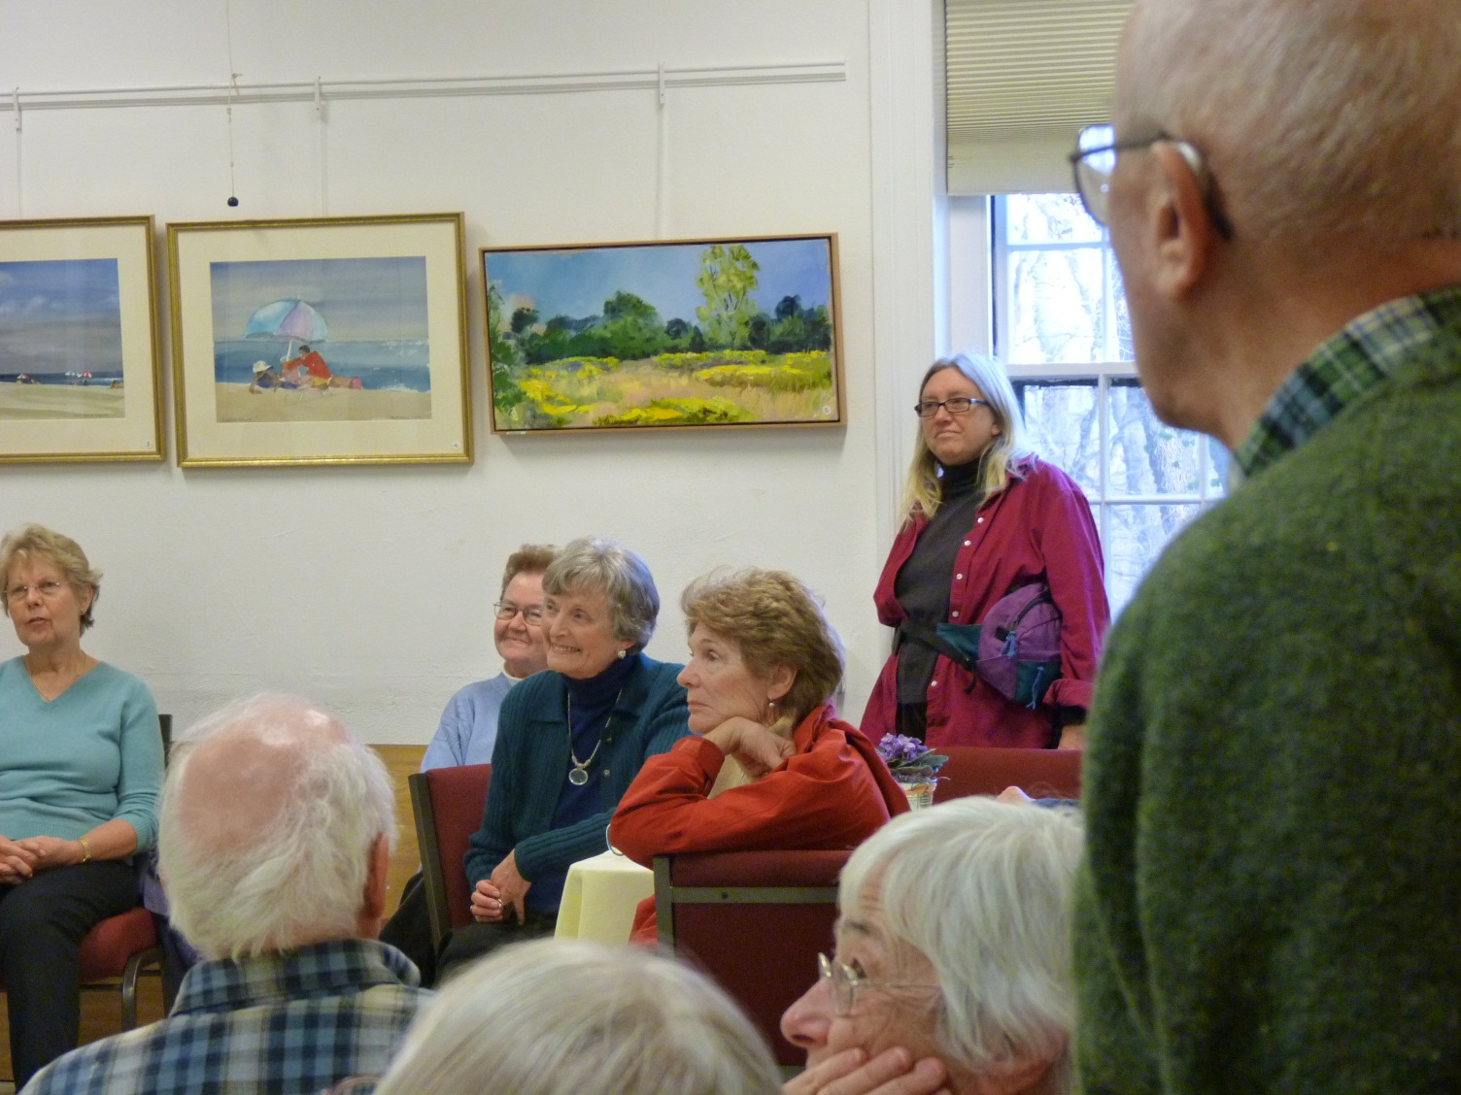
Crowded program space

Slide 21
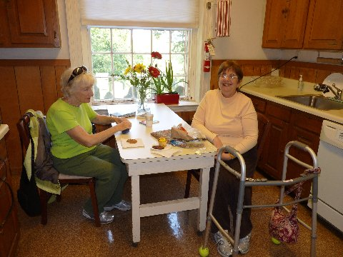
Lack of Space: 1. Lack of social space

Slide 22
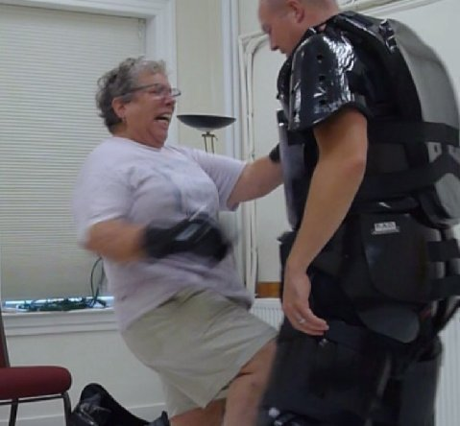
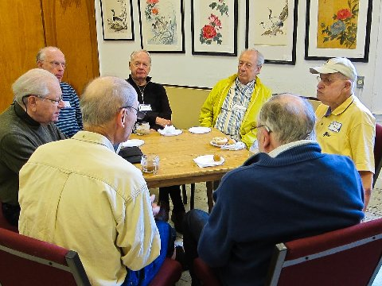
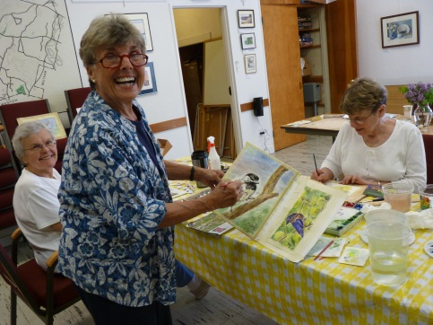
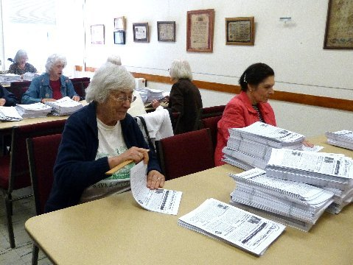
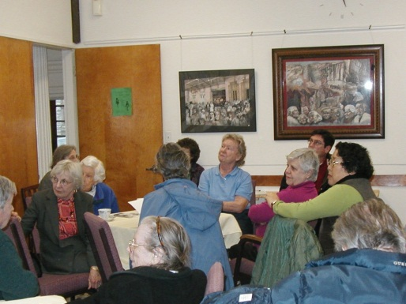
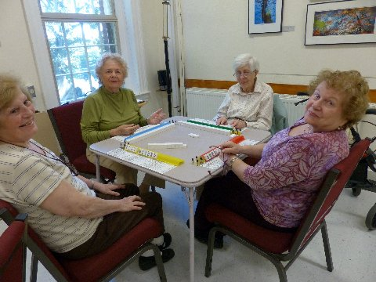
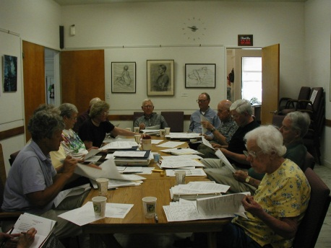
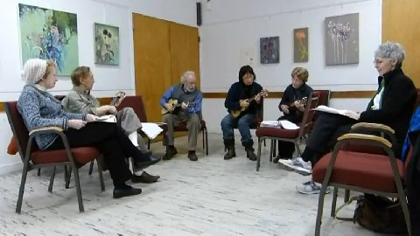
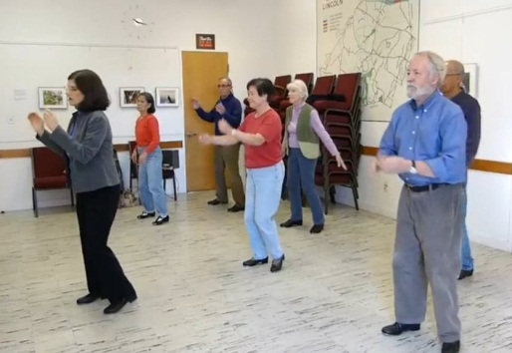
2. Not enough rooms/need to use each room for many activities

Slide 23
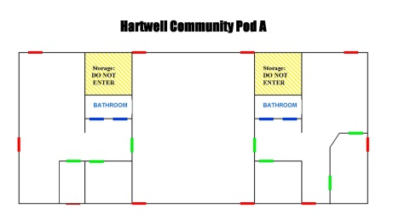
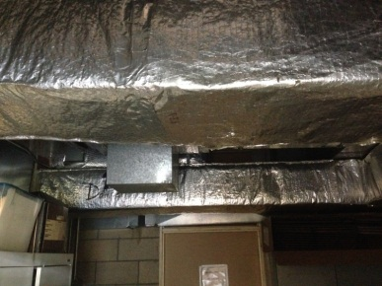
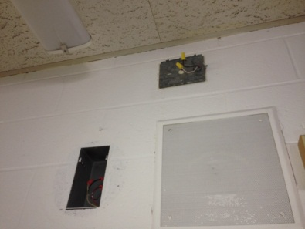
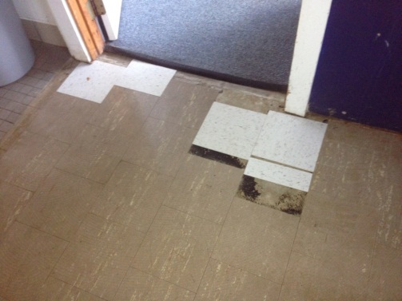
Hartwell Building Site Conditions -Reasonable Square Footage -Designed as classrooms -Limited variety spaces -Rooms can be too large or too small Investment from the Town is needed for: -Accessibility Upgrades -Asbestos Remediation -Building envelope upgrades -Improved fixtures and finishes -Space configuration issues would still remain

Slide 24
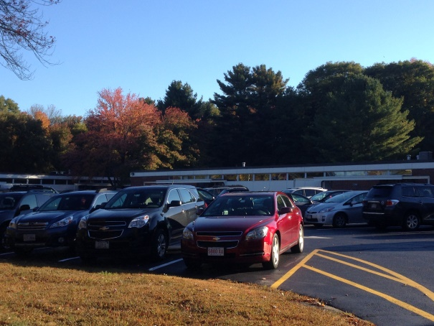
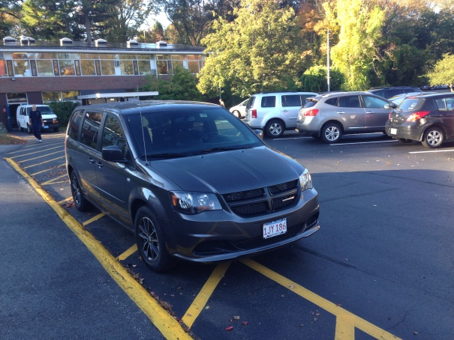
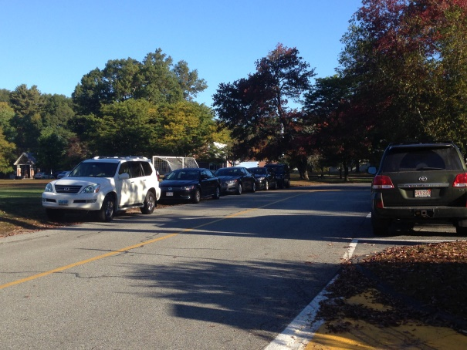
Site parking can be difficult
High use times exist in the morning from
8-9:30AM, 11:30AM-12:30PM and afternoons between 2:30-3:30pm, requiring cars to park illegally in fire lanes and out on Ballfield Road

Slide 25
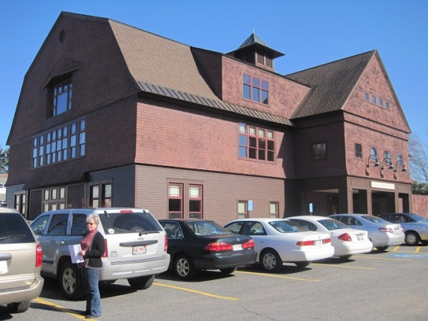
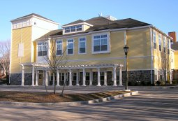
What does a modern community center provide? 1. Adequate and accessible parking
Weston
Bedford

Slide 26
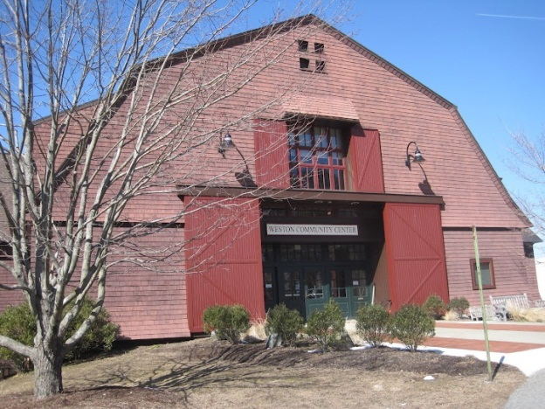
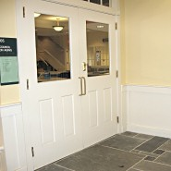
2. Fully accessible, following the principles of universal design
Weston
Bedford

Slide 27
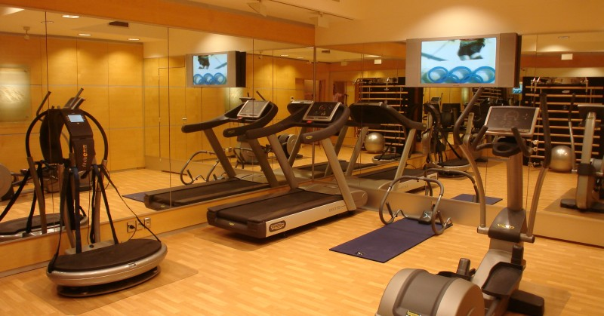
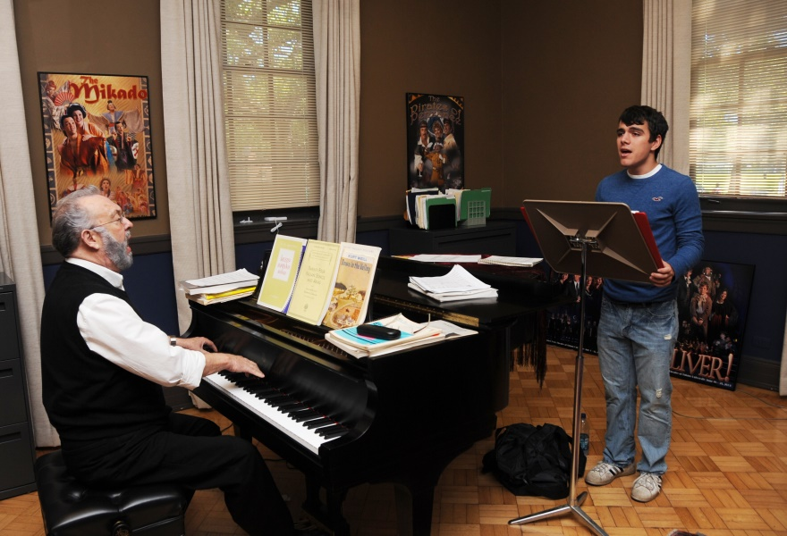
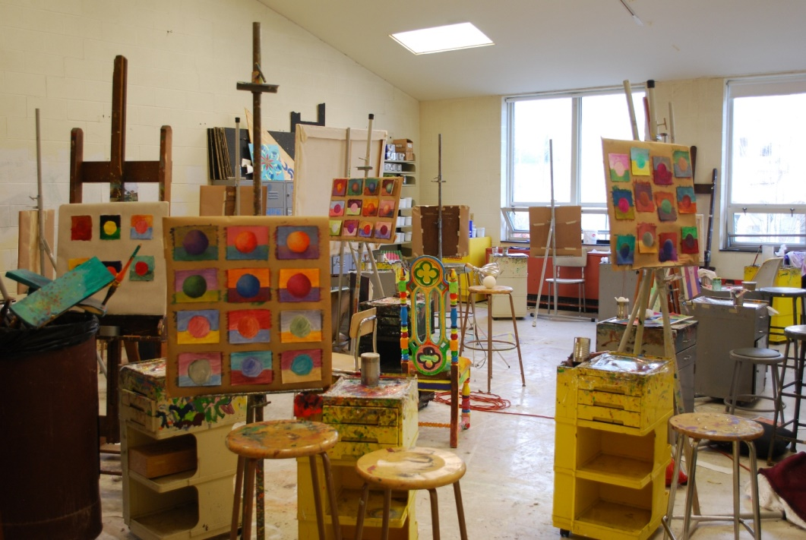
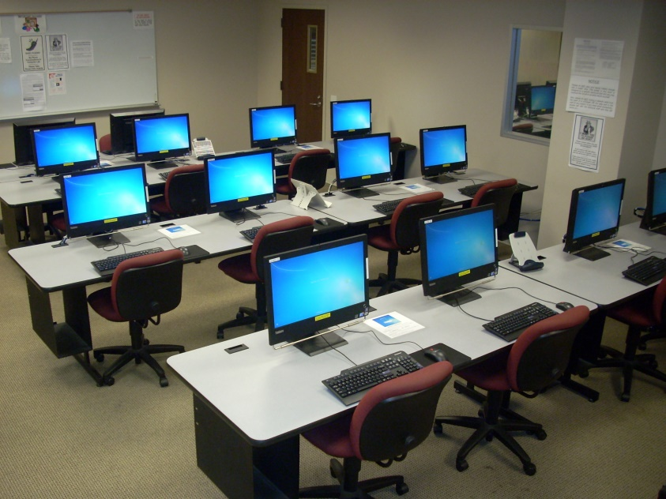
3. Opportunities for diverse programming

Slide 28
3. Opportunities for efficient design
-Programming needs for
COA, Parks & Rec, and
Community Groups are
often similar, providing
shared space / shared
cost opportunities
-Modern construction provides opportunities for a more energy efficient building

Slide 29
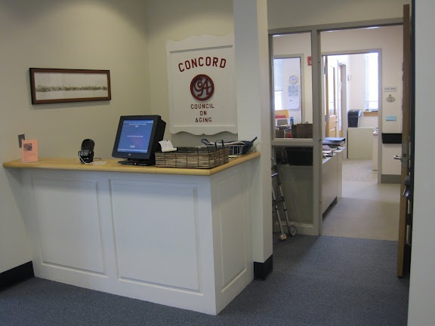
4. Opportunities for confidentiality
Concord

Slide 30
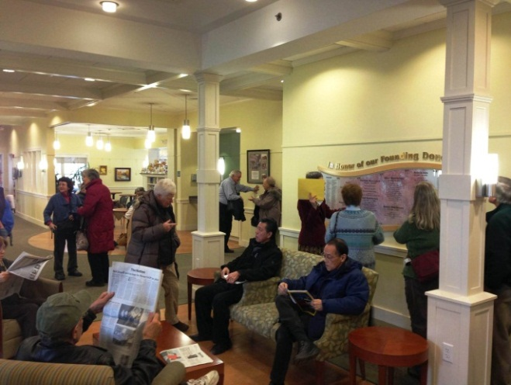
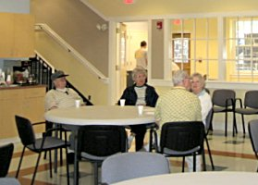
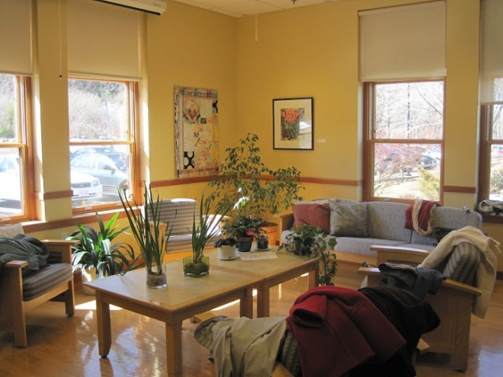
5. Spaces that encourage social interaction and community building
Belmont
Bedford
Weston

Slide 31
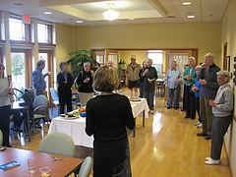
6. Rooms the right size and designed to be flexible, yet still meet the requirements of the activities held in them.
Weston
Belmont

Slide 32
Belmont
Belmont
Belmont
Bedford

Slide 33
Bedford
Natick
Sudbury
Concord

Slide 34
Community Use of Town Spaces

Slide 35
In FY 2013, the Bemis Hall Upstairs was in use 154 out of 303 days, September through June (July and August are too hot to use the upstairs)
5 departments, 19 community orgs, 10 residents
Classes, workshops, lectures, plays, concerts, parties, memorial services, meetings, fundraisers
The School Campus provides space to many organizations including youth soccer, scouts, music lessons, the PTO and the LFA
The Hartwell Pods provide program and storage space for the K-8 and Pre School, PRD, LEAP, and Magic Garden
The Bemis basement is used by the COA, Friends of the COA, Friends of the Library, Historical Society, Minute Men, Celebrations Committee and the Garden Club for storage and book sales.

